Slide 1
Week 2: Information Security Management
Notes:
Key Concepts of Information Security CIA triangle
Privacy
Identification
Authentication
Authorization
Accountability

Slide 2
What Is Management?
The process of achieving objectives using a given set of resources.
Manager
Someone who works with and through other people by coordinating their work activities in order to accomplish organizational goals.
Notes:
Behavioral Types of Leaders
Among leaders, there are three basic behavioral types: autocratic, democratic, and laissez- faire. Autocratic leaders reserve all decision-making responsibility for themselves and are “do as I say” types of managers. Such leaders typically issue an order to accomplish a task and do not usually seek or accept alternative viewpoints. Democratic leaders work in the opposite way, typically seeking input from all interested parties, requesting ideas and suggestions, and then formulating positions that can be supported by a majority.
Each of these two diametrically opposed approaches has its strengths and weaknesses. The autocratic leader may be more efficient given that he or she is not constrained by the neces- sity to accommodate alternative viewpoints. The democratic leader may be less efficient
because valuable time is spent in discussion and debate when planning for the task. On the other hand, the autocratic leader may be the less effective if his or her knowledge is less than sufficient for the task. And the democratic leader may be more effective when dealing with very complex topics and/or those in which subordinates have strongly held opinions.
The laissez-faire leader is also known as the “laid-back” leader. While both autocratic and democratic leaders tend to be action oriented, the laissez-faire leader often sits back and allows the process to develop as it goes, only making minimal decisions to avoid bringing the process to a complete halt.

Slide 3
What Is Management?
Managerial roles
Informational role
Collecting, processing, and using information that can affect the completion of the objective.
Interpersonal role
Interacting with superiors, subordinates, outside stakeholders, and other parties that influence or are influenced by the completion of the task.
Decisional role
Selecting from among alternative approaches, and resolving conflicts, dilemmas, or challenges.
Notes:
Note that there are differences between leadership and management. A leader influences
employees so that they are willing to accomplish objectives. He or she is expected to lead by
example and demonstrate personal traits that instill a desire in others to follow. In other
words, leadership provides purpose, direction, and motivation to those who follow.
By comparison, a manager administers the resources of the organization. He or she creates budgets,
authorizes expenditures, and hires employees. This distinction between a leader and a manager
is important because leaders do not always perform a managerial function, whereas non-managers
are often assigned leadership roles. However, effective managers are also effective leaders.

Slide 4
What Is Management?
Note that there are differences between leadership and management. A leader influences employees so that they are willing to accomplish objectives. He or she is expected to lead by example and demonstrate personal traits that instill a desire in others to follow. In other words, leadership provides purpose, direction, and motivation to those who follow.
By comparison, a manager administers the resources of the organization. He or she creates budgets, authorizes expenditures, and hires employees. This distinction between a leader and a manager is important because leaders do not always perform a managerial function, whereas nonmanagers are often assigned leadership roles. However, effective managers are also effective leaders.
Notes:
Note that there are differences between leadership and management. A leader influences
employees so that they are willing to accomplish objectives. He or she is expected to lead by
example and demonstrate personal traits that instill a desire in others to follow. In other
words, leadership provides purpose, direction, and motivation to those who follow.
By comparison, a manager administers the resources of the organization. He or she creates budgets,
authorizes expenditures, and hires employees. This distinction between a leader and a manager
is important because leaders do not always perform a managerial function, whereas nonmanagers
are often assigned leadership roles. However, effective managers are also effective leaders.

Slide 5
Management Characteristics
Two basic approaches to management
Traditional management theory
Core principles of
planning, organizing, staffing, directing, and controlling (POSDC)
Popular management theory
Categorizes the principles of management into
planning, organizing, leading, and controlling (POLC)

Slide 6
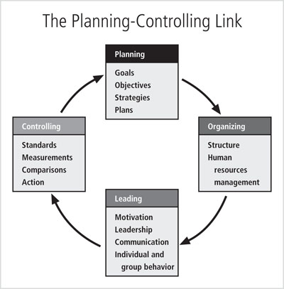
Management Characteristics

Slide 7
Management Characteristics
Planning
The process that develops, creates, and implements strategies for the accomplishment of objectives
Three levels of planning
Strategic: long period of time, five or more years
Tactical: intermediate duration, one to five years
Operational: day-to-day operations
Planning process begins with the creation of strategic plans for the entire organization, then divided up into planning elements

Slide 8
Management Characteristics
Goals and objectives
Goals are the end results
Objectives are intermediate points that allow you to measure progress toward the goal
The management of the planning function within an organization encompasses an entire field of study. It requires an understanding of how to plan and a thorough understanding of project management. Project management is discussed in detail later in this chapter.
Notes:
The management of the planning function within an organization encompasses an entire
field of study. It requires an understanding of how to plan and a thorough understanding
of project management. Project management is discussed in detail later in this chapter.

Slide 9
Management Characteristics
Organizing
The management function dedicated to the structuring of resources to support the accomplishment of objectives
Requires determining what is to be done, in what order, by whom, by which methods, and according to what timeline

Slide 10
Management Characteristics
Leading
Leadership encourages the implementation of the planning and organizing functions
Includes supervising employee behavior, performance, attendance, and attitude
Leadership generally addresses the direction and motivation of the human resource

Slide 11
Management Characteristics
Controlling
Monitoring progress toward completion
Making necessary adjustments to achieve the desired objectives
The control function serves to assure the organization of the validity of the plan
Determines what must be monitored as well as applies specific control tools to gather and evaluate information

Slide 12
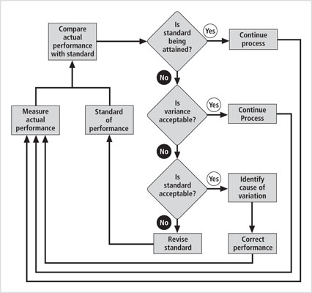
Management Characteristics

Slide 13
Solving Problems
Step 1: Recognize and define the problem
Step 2: Gather facts and make assumptions
Step 3: Develop possible solutions
Step 4: Analyze and compare possible solutions
Step 5: Select, implement, and evaluate a solution
Notes:
Analyze and Compare Possible Solutions Each proposed solution
must be examined and ranked as to its likely success in solving the problem. This analysis
may include reviewing economic, technological, behavioral, and operational feasibilities,
which are described here:
● Economic feasibility—Comparing the costs and benefits of a possible solution with
other possible solutions.
● Technological feasibility—Assessing the organization’s ability to acquire the technology
needed to implement a particular solution.
● Behavioral feasibility—Assessing the likelihood that subordinates will adopt and
support a particular solution rather than resist it.
● Operational feasibility—Assessing the organization’s ability to integrate a particular
solution into its current business processes.

Slide 14
Solving Problems
Analyze and Compare Possible Solutions Each proposed solution must be examined and ranked as to its likely success in solving the problem. This analysis may include reviewing economic, technological, behavioral, and operational feasibilities,which are described here:
Economic feasibility—Comparing the costs and benefits of a possible solution with other possible solutions.
Technological feasibility—Assessing the organization’s ability to acquire the technology needed to implement a particular solution.
Behavioral feasibility—Assessing the likelihood that subordinates will adopt and support a particular solution rather than resist it.
Operational feasibility—Assessing the organization’s ability to integrate a particular solution into its current business processes.
Notes:
Analyze and Compare Possible Solutions Each proposed solution
must be examined and ranked as to its likely success in solving the problem. This analysis
may include reviewing economic, technological, behavioral, and operational feasibilities,
which are described here:
● Economic feasibility—Comparing the costs and benefits of a possible solution with
other possible solutions.
● Technological feasibility—Assessing the organization’s ability to acquire the technology
needed to implement a particular solution.
● Behavioral feasibility—Assessing the likelihood that subordinates will adopt and
support a particular solution rather than resist it.
● Operational feasibility—Assessing the organization’s ability to integrate a particular
solution into its current business processes.

Slide 15
Principles of Information Security Management
The extended characteristics of information security are known as the six P’s
Planning
Policy
Programs
Protection
People
Project Management

Slide 16
Planning
Planning as part of InfoSec management
An extension of the basic planning model already discussed
Included in the InfoSec planning model
Activities necessary to support the design, creation, and implementation of information security strategies

Slide 17
Planning
Types of InfoSec plans
Incident response planning
Business continuity planning
Disaster recovery planning
Policy planning
Personnel planning
Technology rollout planning
Risk management planning
Security program planning
includes education, training and awareness

Slide 18
Policy
Policy
The set of organizational guidelines that dictates certain behavior within the organization
Three general categories of policy
Enterprise information security policy (EISP)
Sets the tone for the InfoSec department across the organization
Issue-specific security policy (ISSP)
Sets of rules of acceptable behavior within a specific technology
System-specific policies (SysSPs)
Technical in nature and control the equipment or technology.

Slide 19
Programs
Programs
InfoSec operations that are specifically managed as separate entities
Example: a security education training and awareness (SETA) program
Other types of programs
Physical security program
complete with fire, physical access, gates, guards, etc.

Slide 20
Protection
Executed through risk management activities
Including risk assessment and control, protection mechanisms, technologies, and tools
Each of these mechanisms represents some aspect of the management of specific controls in the overall information security plan

Slide 21
People
People
The most critical link in the information security program
Managers must recognize the crucial role that people play in the information security program
This area of InfoSec includes security personnel and the security of personnel, as well as aspects of a SETA program

Slide 22
Project Management
Project management
Identifying and controlling the resources applied to the project
Measuring progress
Adjusting the process as progress is made

Slide 23
Project Management
Information security is a process, not a project
Each element of an information security program must be managed as a project
A continuous series, or chain, of projects
Some aspects of information security are not project based
They are managed processes (operations)
Monitoring internal/external environments, ongoing risk assessments, continuous vulnerability assessment.

Slide 24
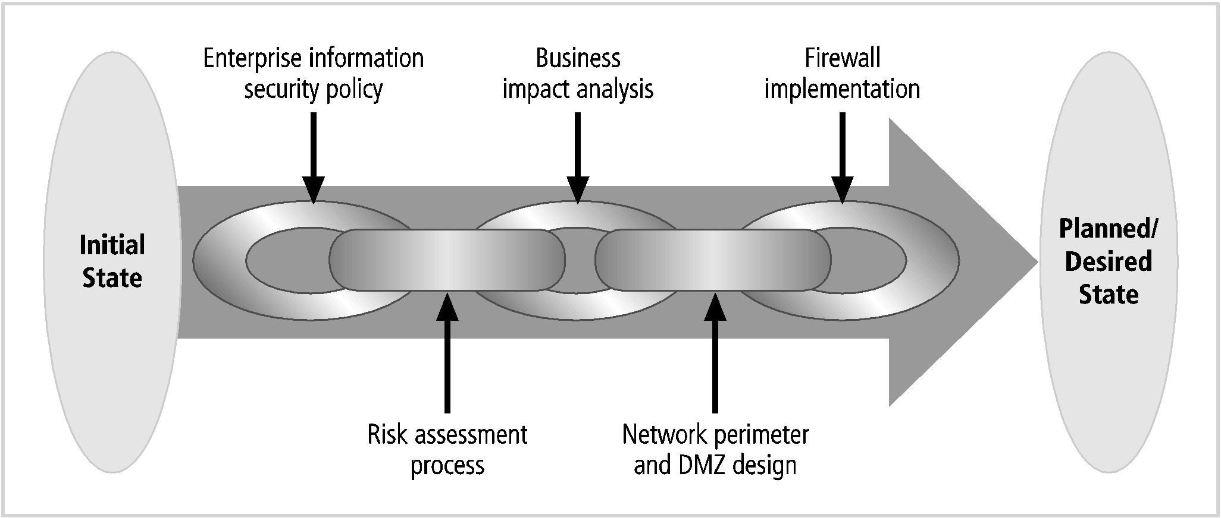
Project Management
Notes:
each link in this
chain of projects could be a specific project. Note that each project is to be guided by a security
systems development life cycle (SecSDLC) methodology, as will be described in later chapters.

Slide 25
Project Management
Project Management
The application of knowledge, skills, tools, and techniques to project activities to meet project requirements
Accomplished through the use of processes
Such as initiating, planning, executing, controlling, and closing
Involves the temporary assemblage resources to complete a project
Some projects are iterative, occurring regularly (e.g., budgets)

Slide 26
Applying Project Management to Security
First identify an established project management methodology
PMBoK (Project Management Body of Knowledge) is considered the industry best practice
Other project management practices exist

Slide 27
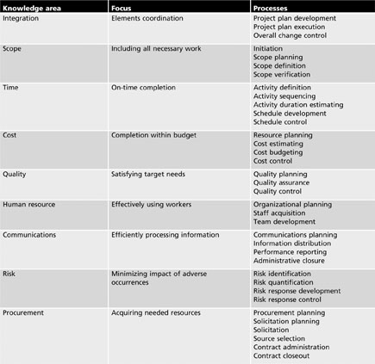
Project Management Knowledge Areas

Slide 28
Project integration management
Project integration management
Includes the processes required to coordinate occurs between components of a project
Elements of a project management effort that require integration
The development of the initial project plan
Monitoring of progress during plan execution
Control of plan revisions
Control of the changes made to resource allocations
As measured performance causes adjustments to the project plan

Slide 29
Project integration management
Project plan development
The process of integrating all of the project elements into a cohesive plan
Goal is to complete the project within the allotted work time using no more than the allotted project resources
Core components of project plan
Work time, resources, and project deliverables
Changing one element affects the other two
Likely requires revision of the plan

Slide 30
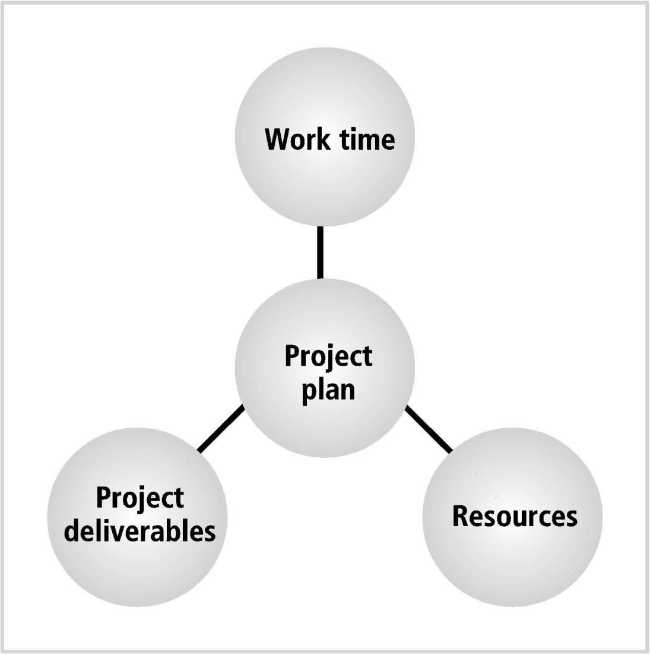
Project integration management
Notes:
Project Plan Inputs

Slide 31
Project integration management
When integrating the disparate elements of a complex information security project, complications are likely to arise
Conflicts among communities of interest
Far-reaching impact
Resistance to new technology

Slide 32
Project scope management
Project scope management
Ensures that project plan includes only those activities necessary to complete it
Scope creep
The quantity or quality of project deliverables is expanded from the original project plan
Major processes
scope planning, definition, verification and change control

Slide 33
Project time management
Project time management
Ensures that project is finished by identified completion date while meeting objectives
Failure to meet project deadlines is among most frequently cited failures in project management
Many missed deadlines are caused by poor planning

Slide 34
Project time management
Project time management includes the following processes
Activity definition
Activity sequencing
Activity duration estimating
Schedule development
Schedule control

Slide 35
Project cost management
Project cost management
Ensures that a project is completed within the resource constraints
Some projects are planned using only a financial budget
From which all resources must be procured
Includes resource planning, cost estimating, cost budgeting, and cost control

Slide 36
Project quality management
Project quality management
Ensures project meets project specifications
Quality objective met
When deliverables meet requirements specified in project plan
A good plan defines project deliverables in unambiguous terms
For easy comparison against actual results
Includes quality planning, quality assurance and quality control

Slide 37
Project human resource management
Project human resource management
Ensures personnel assigned to project are effectively employed
Staffing a project requires careful estimates of effort required
Unique complexities
Extended clearances
Deploying technology new to the organization
Includes organizational planning, staff acquisition and team development

Slide 38
Project communications management
Project communications management
Conveys details of project activities to all involved
Includes the creation, distribution, classification, storage, and destruction of documents, messages, and other associated project information
Includes communications planning, information distribution, performance reporting and administrative closure

Slide 39
Project risk management
Project risk management
Includes the processes necessary to assesses, mitigates, manages, and reduces the impact of adverse occurrences on the project
Includes risk identification, risk quantification, risk response development and risk response control

Slide 40
Project procurement
Project procurement
Acquiring needed project resources
Project managers may simply requisition resources from organization, or may have to purchase
Includes procurement planning, solicitation planning, solicitation, source selection, contract administration and contract closeout

Slide 41
Project Management Tools
Many tools exist
Most project managers combine software tools that implement one or more of the dominant modeling approaches
Project management certification
The Project Management Institute (PMI)
Leading global professional association
Sponsors two certificate programs: The Project Management Professional (PMP) and Certified Associate in Project Management (CAPM)

Slide 42
Project Management Tools
Projectitis
Occurs when the project manager spends more time documenting project tasks, collecting performance measurements, recording project task information, and updating project completion forecasts than accomplishing meaningful project work
Precursor to projectitis
Developing an overly elegant, microscopically detailed plan before gaining consensus for the work required

Slide 43
Work Breakdown Structure
Work breakdown structure (WBS)
Simple planning tool for creating a project plan
The project plan is first broken down into a few major tasks
Each task is placed on the WBS task list

Slide 44
Work Breakdown Structure
Determine minimum attributes for each task
The work to be accomplished (activities and deliverables)
Estimated amount of effort required for completion in hours or workdays
The common or specialty skills needed to perform the task
Task interdependencies

Slide 45
Work Breakdown Structure
As the project plan develops, additional attributes can be added
Estimated capital and noncapital expenses for the task
Task assignment according to specific skills
Start and end dates
Work to be accomplished
Amount of effort
Task dependencies
Start and ending dates

Slide 46
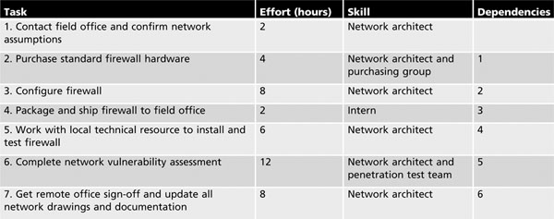
Work Breakdown Structure

Slide 47
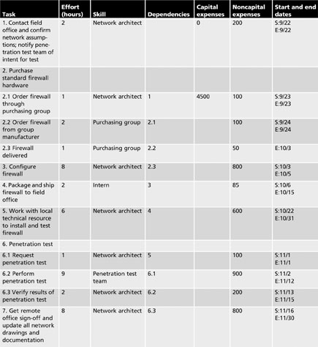
Work Breakdown Structure

Slide 48
Task-Sequencing Approaches
Many possibilities for task assignment and scheduling
For modest and large size projects
A number of approaches can assist the project manager in this sequencing effort
Network scheduling
Refers to the web of possible pathways to project completion

Slide 49
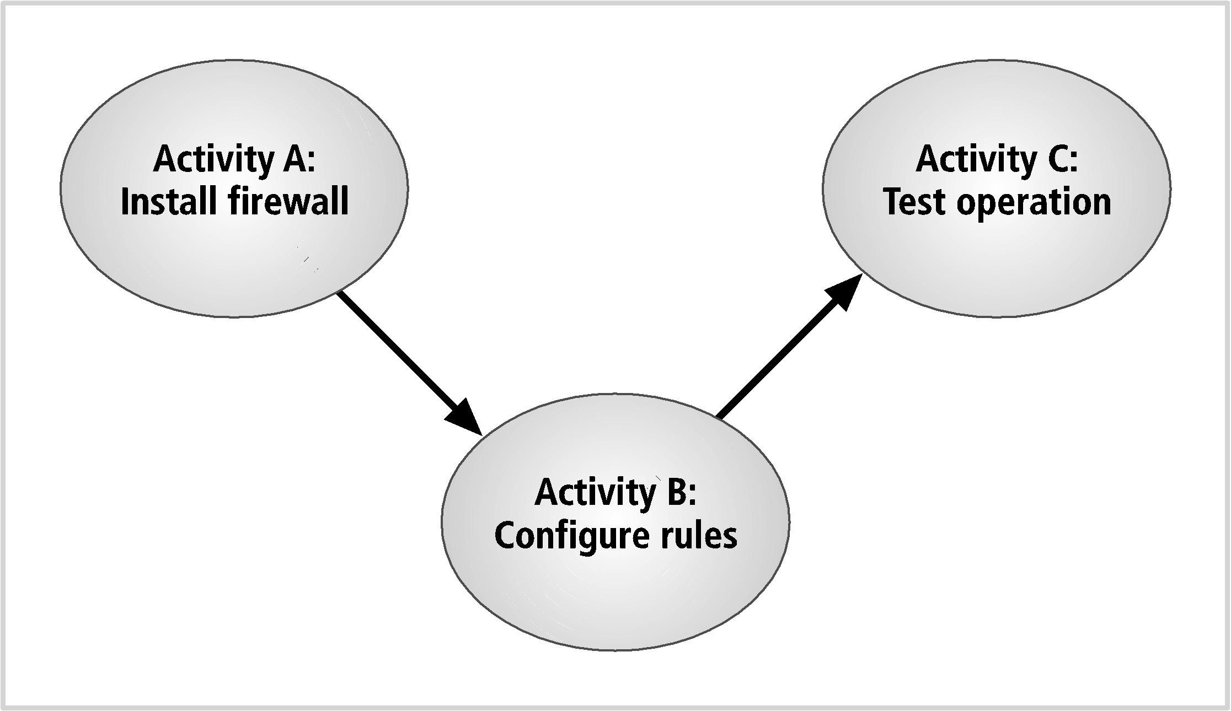
Task-Sequencing Approaches

Slide 50
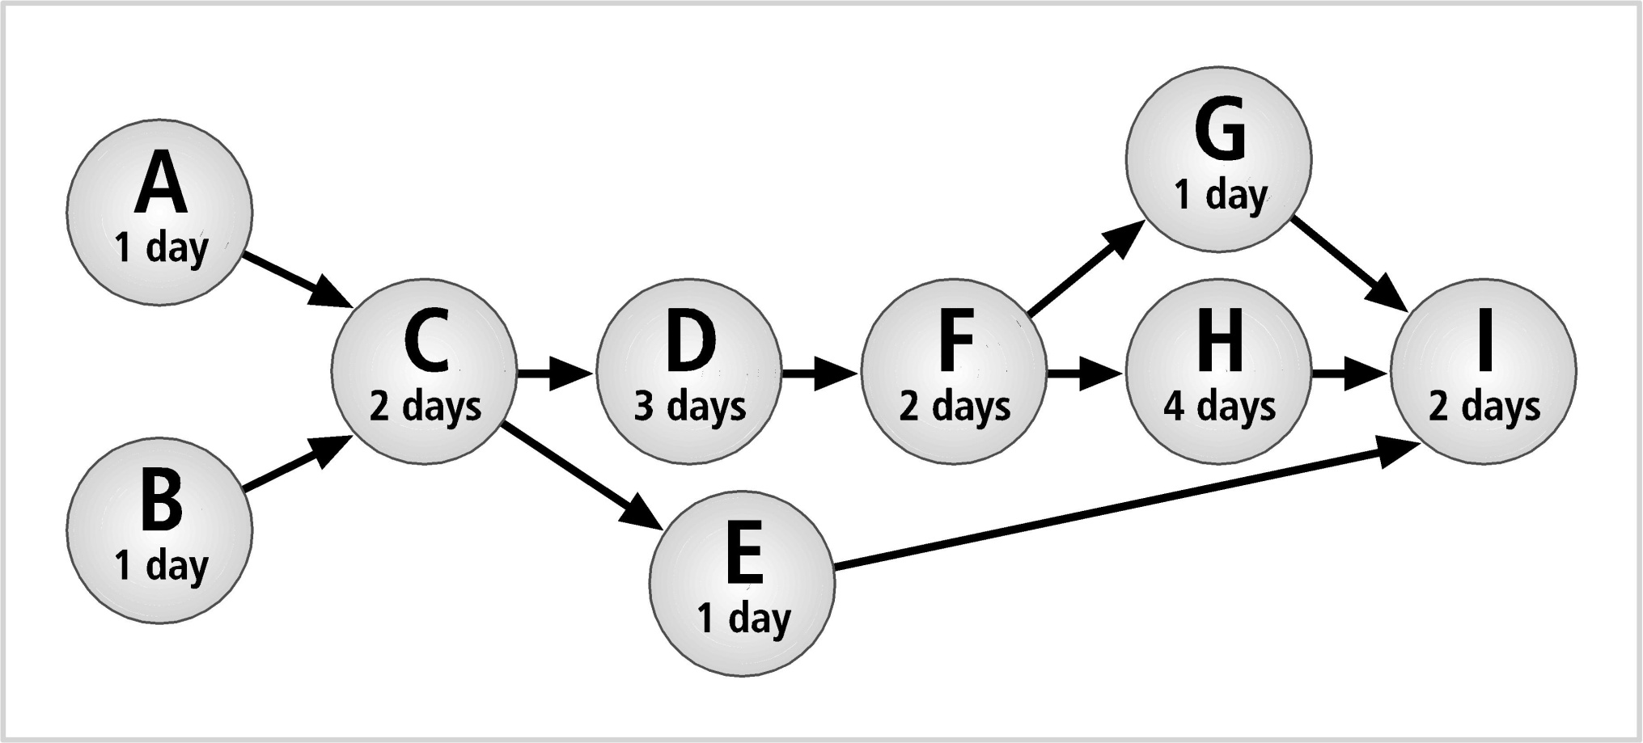
Task-Sequencing Approaches

Slide 51
Task-Sequencing Approaches
Program Evaluation and Review Technique (PERT)
Most popular technique
Originally developed in the late 1950’s for government-driven engineering projects

Slide 52
Task-Sequencing Approaches
Three key questions
How long will this activity take?
What activity occurs immediately before this activity can take place?
What activity occurs immediately after this activity?
Determine the critical path
By identifying the slowest path through the various activities

Slide 53
Task-Sequencing Approaches
Slack time
How much time is available for starting a noncritical task without delaying the project as a whole
Tasks which have slack time are logical candidates for accepting a delay

Slide 54
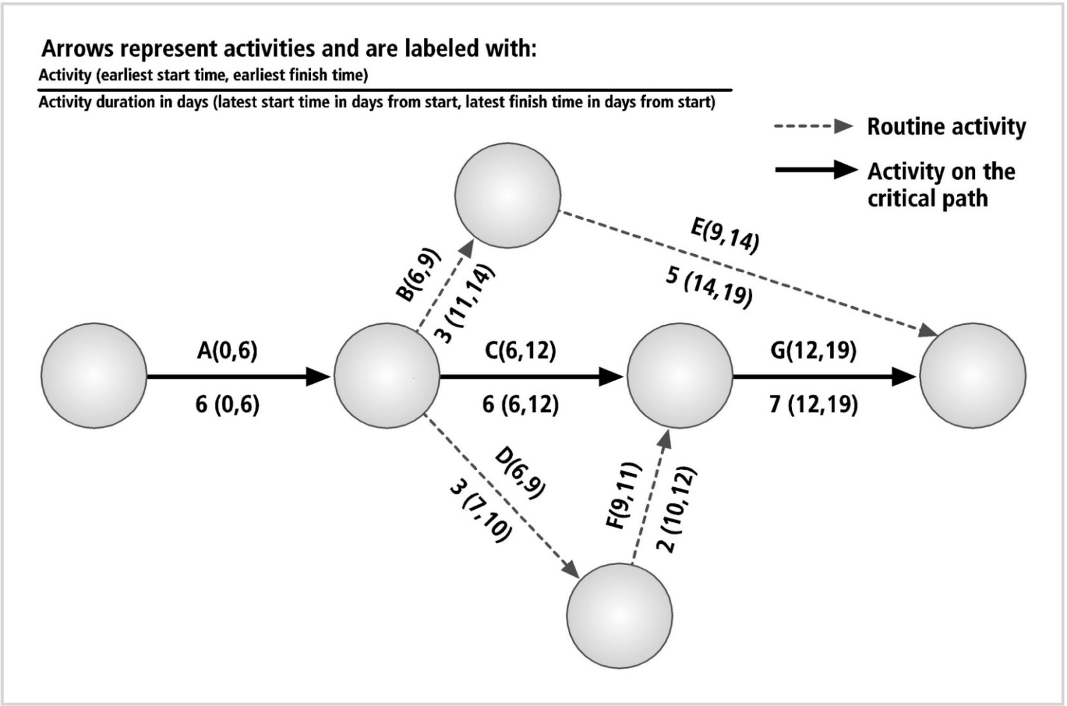
Task-Sequencing Approaches

Slide 55
Task-Sequencing Approaches
PERT advantages
Makes planning large projects easier
By facilitating the identification of pre- and post- activities
Determines the probability of meeting requirements
Anticipates the impact of system changes
Presents information in a straightforward format understood by managers
Requires no formal training

Slide 56
Task-Sequencing Approaches
Program Evaluation and Review Technique （PERT） disadvantages
Diagrams can be awkward and cumbersome, especially in very large projects
Diagrams can become expensive to develop and maintain
Due to the complexities of some project development processes
Difficulty in estimating task durations
Inaccurate estimates invalidate any close critical path calculations

Slide 57
Task-Sequencing Approaches
Gantt chart
Easy to read and understand; easy to present to management
Easier to design and implement than the PERT diagrams, yielding much of the same information
Lists activities on the vertical axis of a bar chart, and provides a simple time line on the horizontal axis

Slide 58
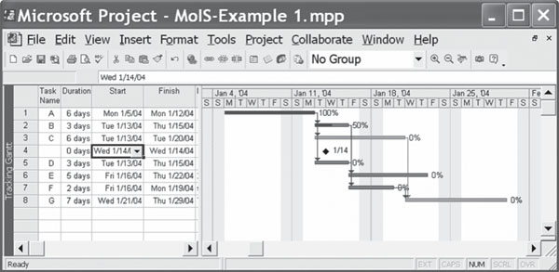
Task-Sequencing Approaches
Notes:
As shown in Figure 1-10, the Gantt chart
can provide a wealth of information in a simple format. Activity A has been completed; activity
B is ahead of schedule; activity C is behind schedule. Milestones can be added to individual
activities and are usually represented by a numbered triangle just above the bar.
These milestones might include the completion of a key report or a component that requires outside
interventions. Whatever the case, this method of tracking has proven so simple to use, yet so
effective, that it is frequently the preferred method for tracking project progress.

Slide 59
Automated Project Tools
Microsoft Project
A widely used project management tool
Keep in mind:
A software program is no substitute for a skilled and experienced project manager
Manager must understand how to define tasks, allocate scarce resources, and manage assigned resources
A software tool can get in the way of the work
Choose a tool that you can use effectively

